Slide 1

CMR Technical Campus Department of Information Technology
Major Project Stage – 2 Review - 2
Project Title: Multimodal Analysis of Hate Speech Detection in Memes using Meme Sentinel-XT
Project Supervisor:​
Name:​ M. Ramesh Babu
Designation: Assistant Professor
Presented By:​
Batch No: 17
H. No: 237R5A1203 Name: B. Shivaram
H. No: 227R1A1241 Name: Mohammed Parvez
H. No: 227R1A1209 Name: A. Anil

Slide 2
Index
Introduction and Overview
Existing System
Disadvantages of Existing System
Proposed System
Advantages of Proposed System
Hardware and Software Requirements
Novelty of the Project
System Architecture
Modules
UML Diagrams
Source Code
Results
Conclusion and Future Enhancements
References
GitHub Link

Slide 3
Introduction & Overview
This project focuses on developing an automated system to detect hate speech in internet memes using multimodal deep learning techniques, with the aim of reducing manual moderation effort and improving content safety on social media platforms.
The proposed system analyzes both the image and embedded text in memes by using Vision Transformer (ViT) for visual feature extraction and XLNet for understanding textual context, enabling accurate identification of offensive and hateful content.
The system can be effectively used by social media platforms, content moderation teams, and online communities to provide a fast, accurate, and scalable solution for detecting hate speech in meme-based content.

Slide 4
Existing System
Manual Content Moderation:
The existing system depends on human reviewers who manually examine memes by looking at images and reading the text to identify hateful or offensive content.
Text-Based Detection:
Most automated systems analyze only the textual part of memes and ignore visual information, which results in poor understanding of the actual message.
Example :
Platforms like Facebook (Meta), Instagram, Twitter (X), and Reddit already use automated content moderation systems to detect:
Hate speech, Offensive language, Harassment, and Harmful visual content

Slide 5
Existing System Disadvantages
Text-based systems fail to understand images, symbols, and gestures that change the meaning of meme content.
Hateful memes with neutral text are often missed, leading to false negatives and poor detection accuracy.
Human moderation is slow, costly, and depends on personal judgment, causing inconsistency and bias.
The system cannot handle the large and fast-growing volume of memes shared on social media platforms.
Existing systems struggle with sarcasm, cultural references, and implicit hate present in memes.

Slide 6
Proposed System
The proposed system introduces MemeSentinel-XT, an automated multimodal hate speech detection system that analyzes both the image and text present in memes.
The system uses Vision Transformer (ViT) to extract visual features from meme images and XLNet to understand the meaning and context of embedded text.
By combining image and text features through a multimodal fusion and classification framework, the system accurately identifies hateful and offensive memes.
The proposed approach provides a fast, scalable, and reliable solution suitable for real-time content moderation on social media platforms.

Slide 7
Proposed System Advantages
Multimodal Analysis - The system analyzes both image and text, providing better understanding of meme content.
Higher Accuracy - Combining visual and textual features reduces false detection and improves classification accuracy.
Handles Hidden Hate - Effectively detects implicit, sarcastic, and context-based hate speech in memes.
Reduced Human Effort - Minimizes the need for manual moderation and ensures consistent decision-making.

Slide 8
Hardware and Software Requirements
Hardware Requirements:
Processor: Intel i5 or higher
RAM: Minimum 8 GB
Storage: 512 GB SSD
Software Requirements:
Operating System: Windows / Linux
Programming Language: Python
Frameworks: PyTorch, Transformers
Libraries: OpenCV, NLTK, Scikit-learn
Development Tools: VS Code / Jupyter Notebook

Slide 9
Novelty
This project introduces a multimodal hate speech detection system that analyzes both image and text in memes, overcoming the limitations of traditional text-only approaches.
It uses advanced transformer models such as Vision Transformer (ViT) for image understanding and XLNet for capturing deep textual context and meaning.
The proposed system provides a more accurate, scalable, and context-aware solution for detecting hidden and implicit hate speech in real-world social media memes.

Slide 10
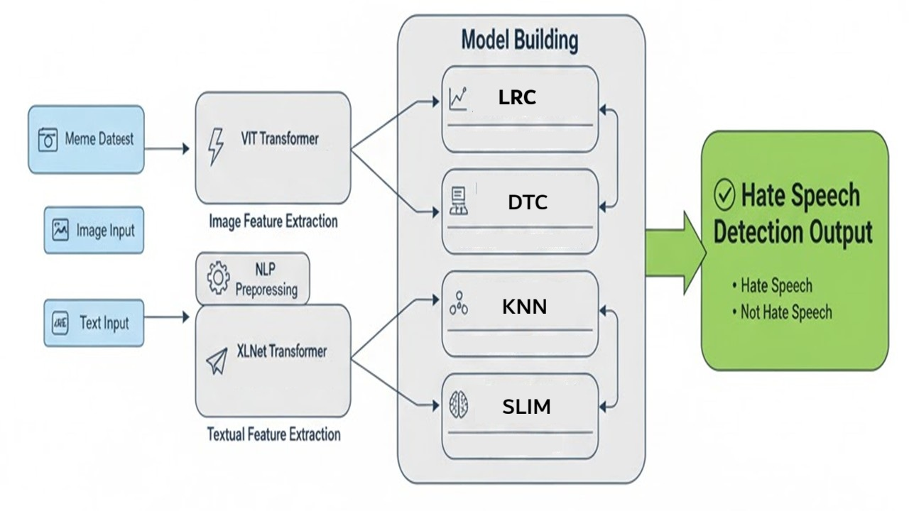
System Architecture

Slide 11
Modules
Data Acquisition & Preprocessing:
This module collects meme images and extracts embedded text using OCR(Optical Character Recognition). Both image and text data are cleaned, resized, and normalized for further processing.
Feature Extraction:
Visual features are extracted using Vision Transformer (ViT), while textual features are generated using XLNet to understand the meaning and context of meme text.
Multimodal Fusion & Classification:
The extracted image and text features are combined and classified to identify whether a meme contains hate speech or non-hateful content.

Slide 12
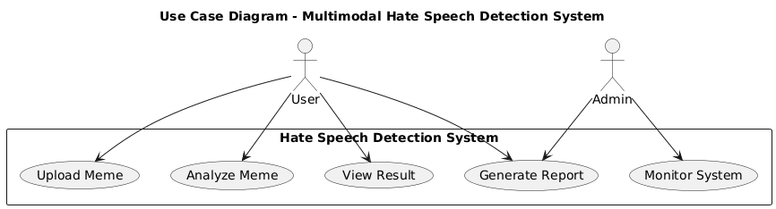
UML DIAGRAMS:
Use case Diagram

Slide 13
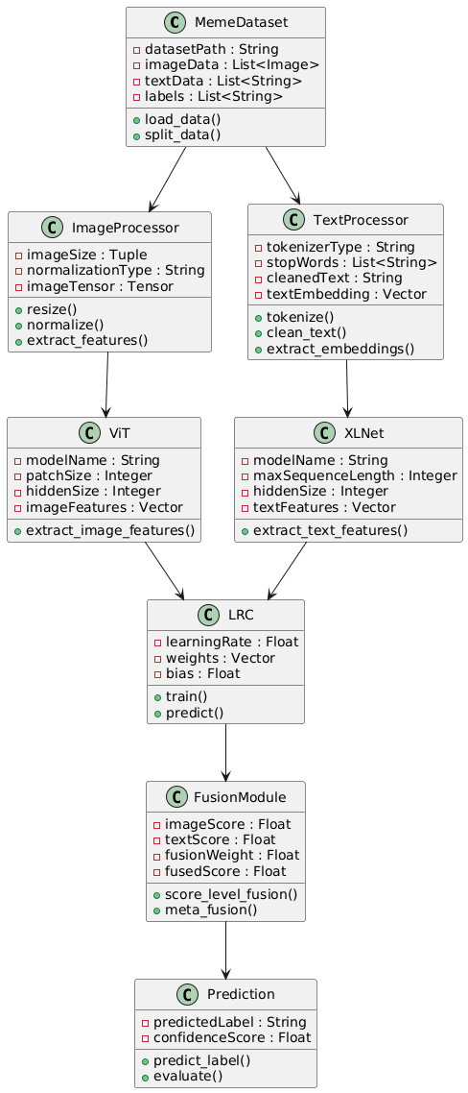
Class Diagram

Slide 14
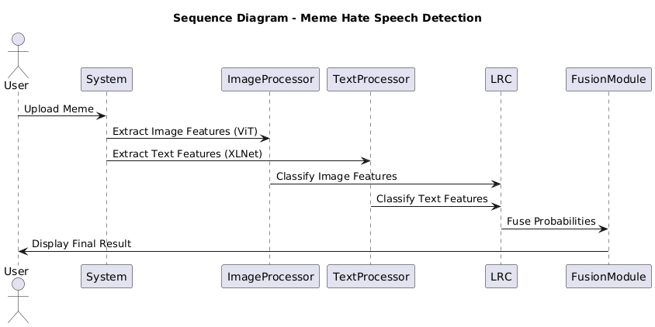
Sequence Diagram

Slide 15
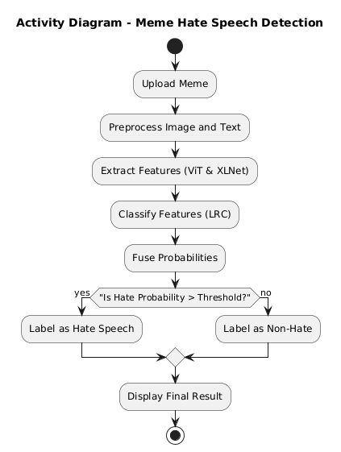
Activity Diagram

Slide 16
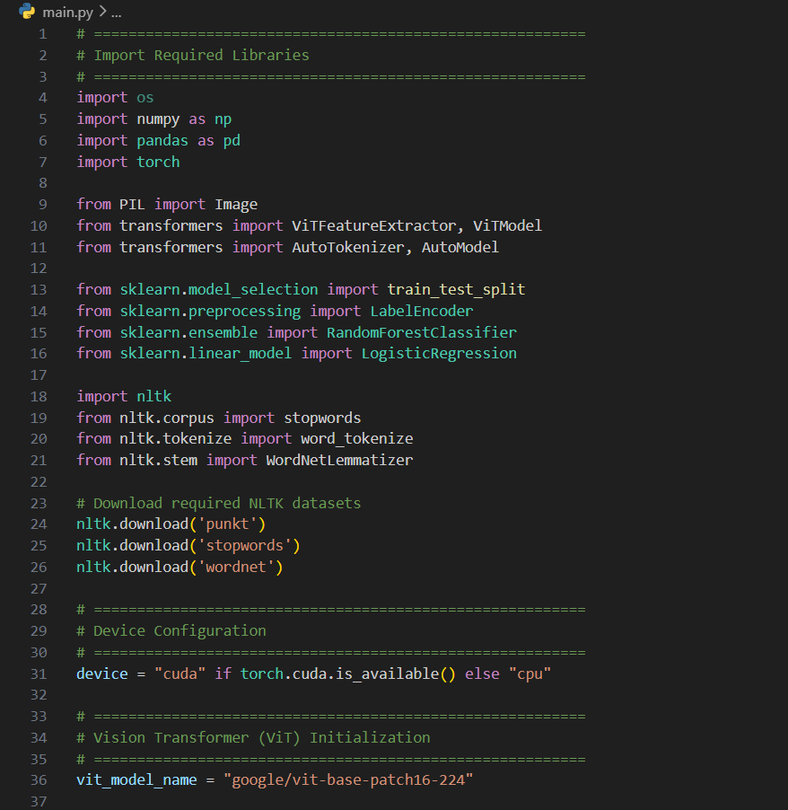
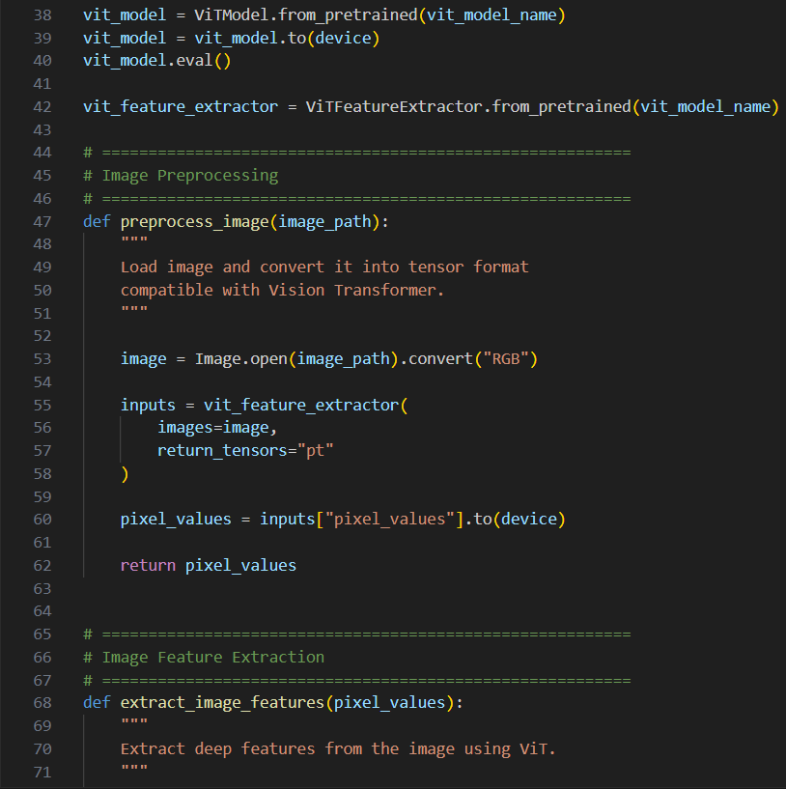
Source Code

Slide 17
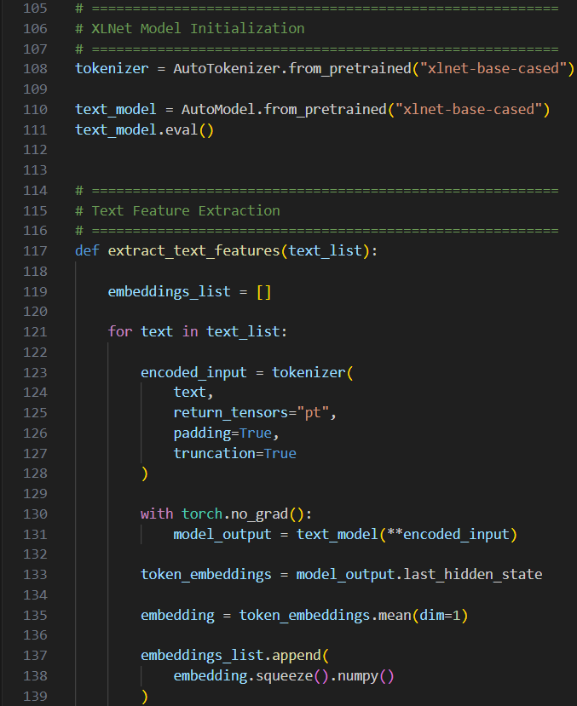
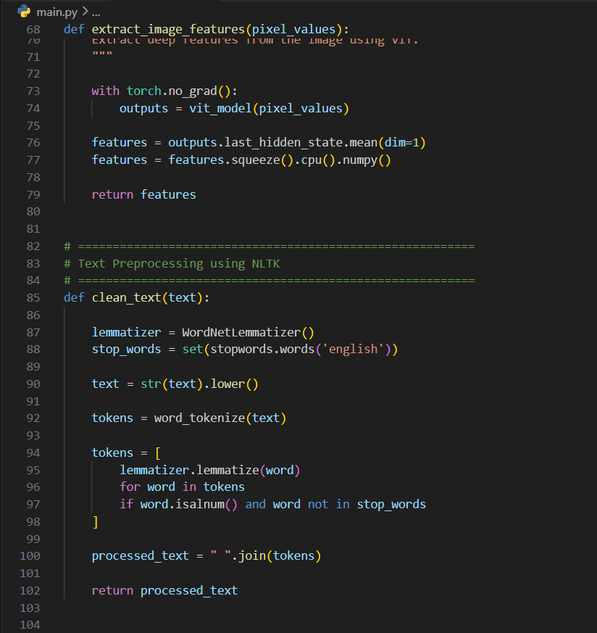
Source Code

Slide 18
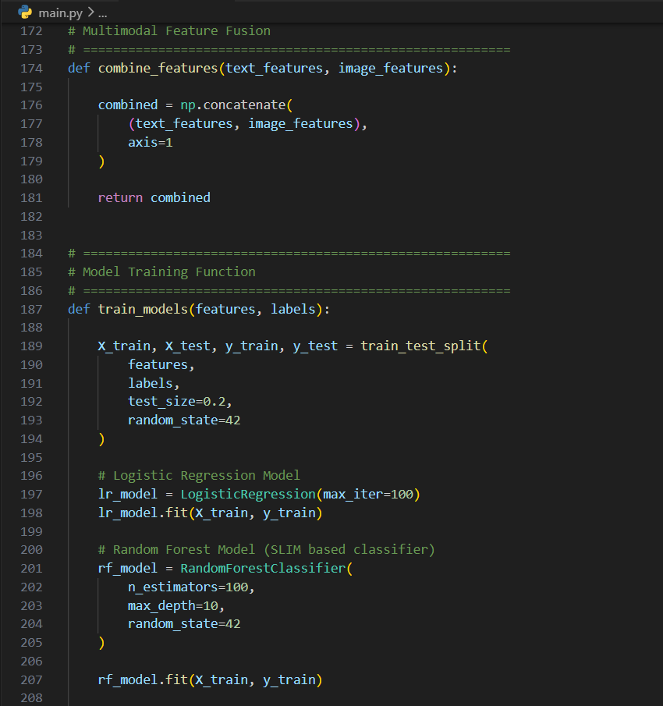
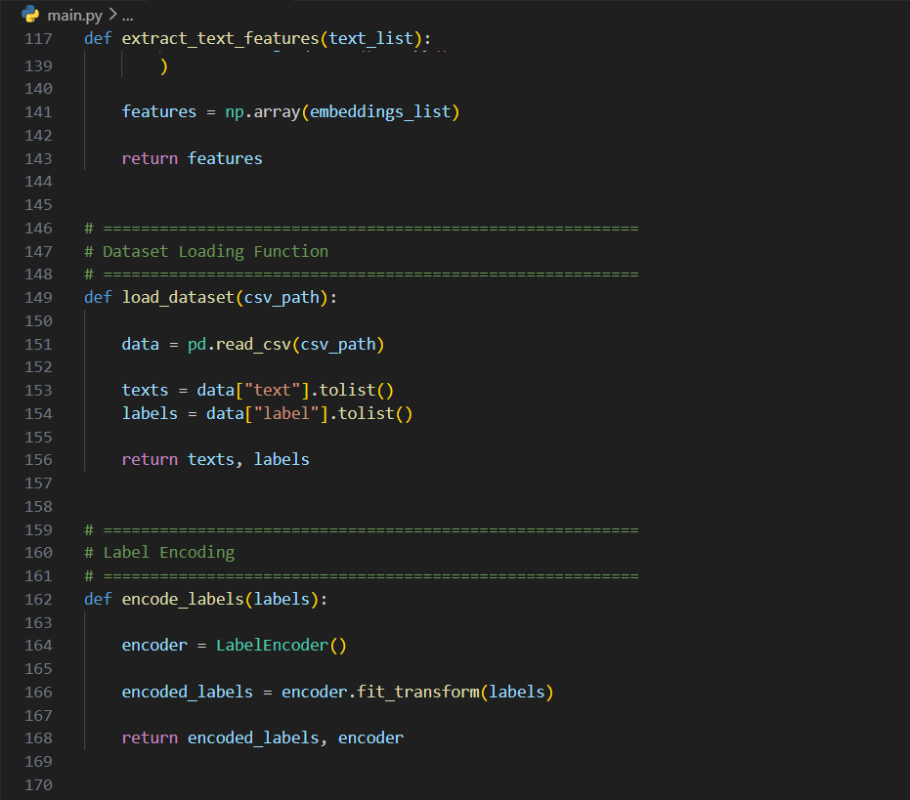
Source Code

Slide 19
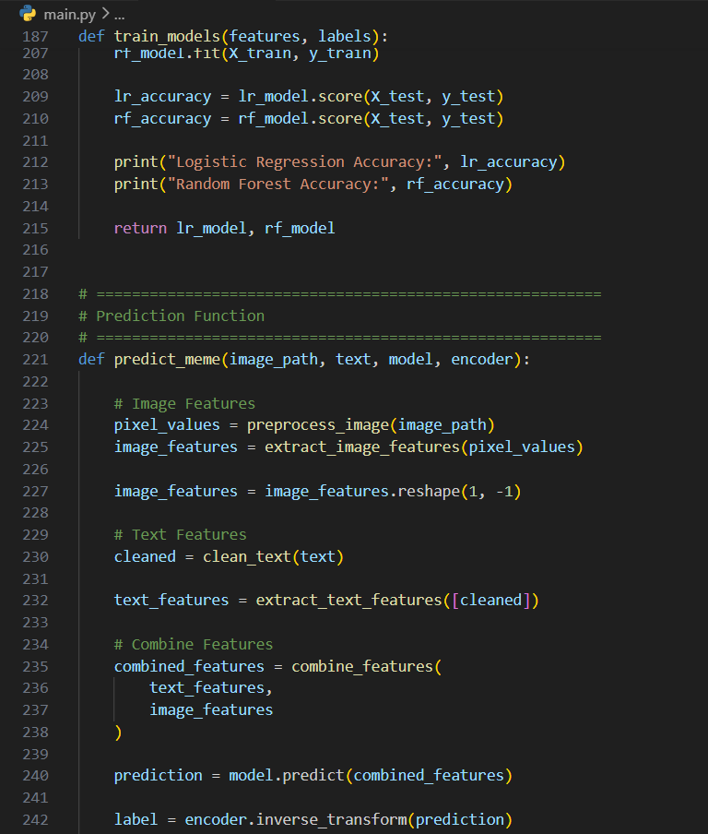
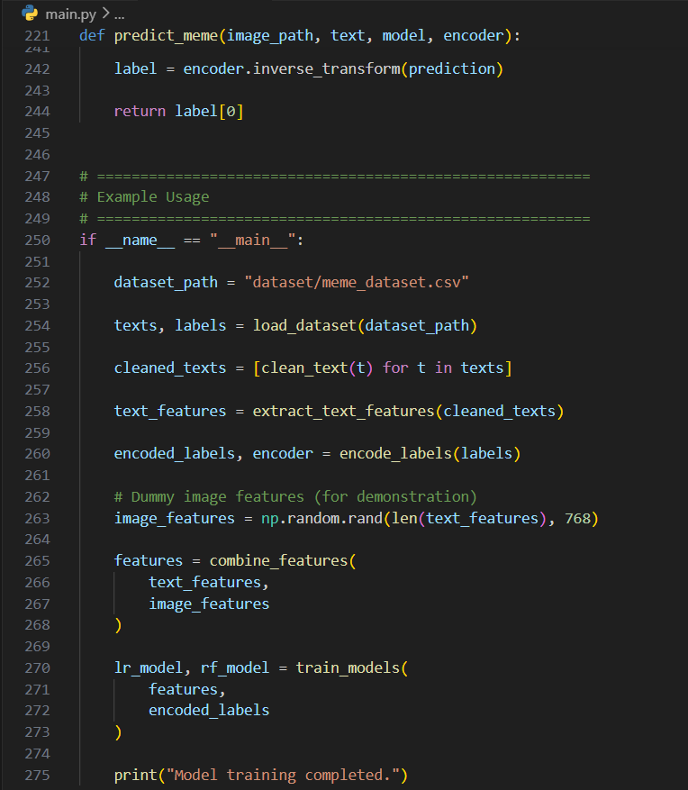
Source Code

Slide 20

Results
GUI of home screen of hate speech detection in memes

Slide 21
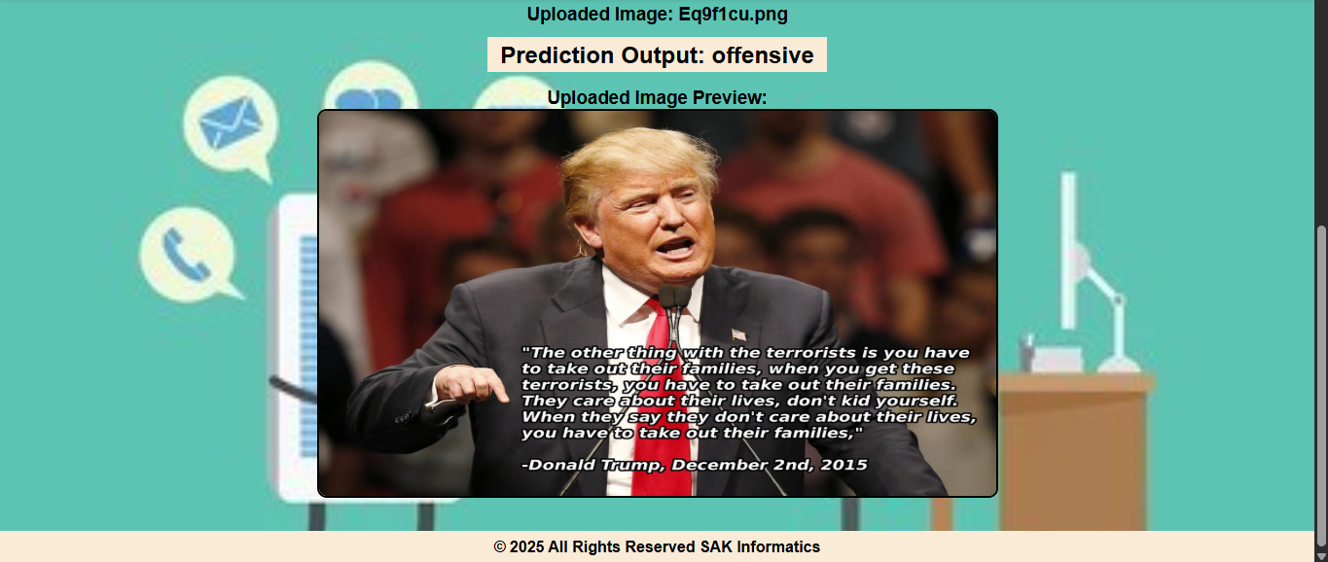
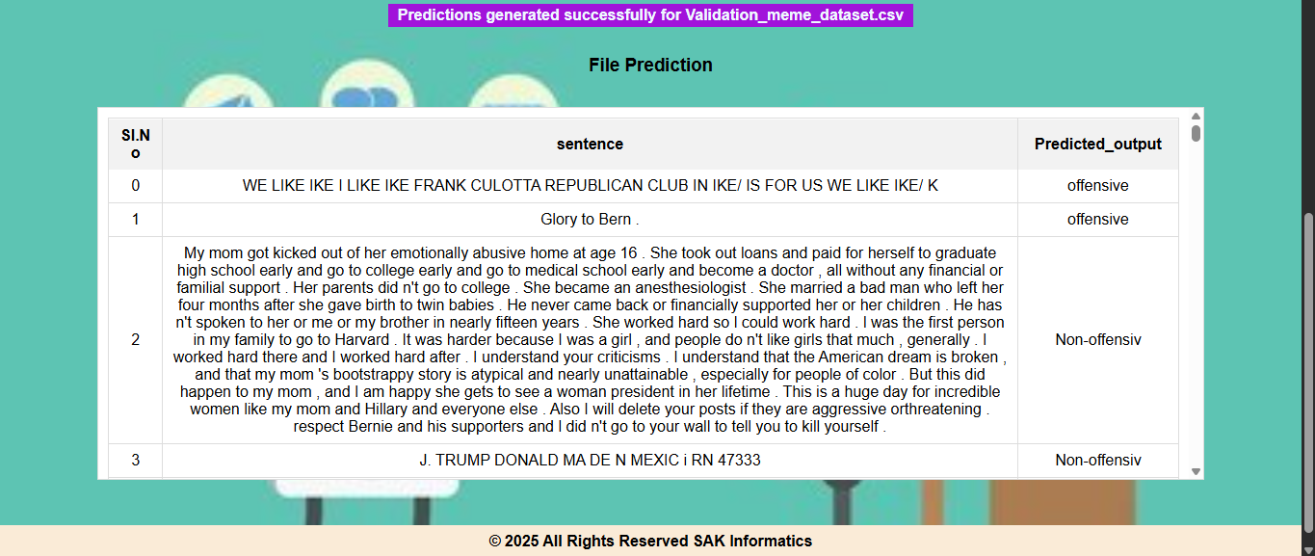
Results
Final Model Prediction of Image and Text output

Slide 22
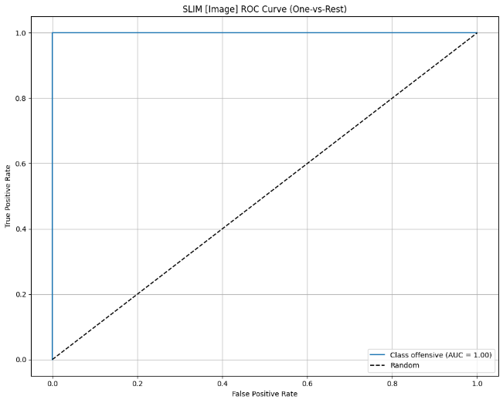

Results
Training and Validation Accuracy and Loss Curves for the Proposed SLIM Model

Slide 23
Conclusion and Future Enhancements
The project successfully developed a multimodal hate speech detection system using the MemeSentinel-XT framework by combining ViT and XLNet, along with the proposed SLIM (Supersparse Linear Integer Model) classifier. This integration improved classification accuracy and interpretability compared to traditional methods. The system shows strong potential for real-world content moderation and online safety applications.
Future Enhancements
Future work can focus on expanding datasets, improving multimodal architectures like CLIP, and enhancing the SLIM model for better performance. Deployment on cloud platforms with multilingual support can enable real-time large-scale monitoring. These improvements will make the system more scalable and globally effective.

Slide 24
References
J. Mao et al., “Self-Attention Fusion Model”, J Supercomput, 2025.
S. Li et al., “SVM Hate Speech Detection”, Info., 2025.
A. Naseeb et al., “Multi-model Hate Detection”, Algorithms, 2025.
G. Arya et al., “CLIP-based Meme Detection”, IEEE Access, 2024.
K. Mnassri et al., “Multilingual GAN Model”, Entropy, 2024.
A. Yadav et al., “NLP + BERT Models”, Appl. Sci., 2024.
A. Hamza et al., “Multimodal Hate Meme Classification”, ACM TALLIP, 2023.
M.R. Karim et al., “Bengali Multimodal Hate Detection”, Springer, 2023.
M. Bilal et al., “Roman Urdu Hate Speech Detection”, Sensors, 2023.

Slide 25
GitHub Link
https://github.com/iamparvezali085/Major-project-A17

Slide 26


